Slide 1
WELDING AND FABRICATION TECHNOLOGY
UNIT 1
APPLICATION OF HEALTH, SAFETY AND ENVIRONMMENTAL RULES
NCII

Slide 2
LEARNING OUTCOMES
DEMONSTRATE KNOWLEDGE OF HEALTH, SAFETY AND ENVIRONMENTAL RULES
DEMONSTRATE KNOWLEDGE OF SAFETY IN REPAIRING TANKS.
DEMONSTRATE SKILLS IN OPERATING FIREFIGHTING EQUIPMENT.
DEMONSTRATE KNOWLEDGE OF THE EFFECTS OF WELDING FUMES.

Slide 3
LO 1 Demonstrate knowledge of Health, Safety and Environmental rules
PC (a) State uses of Personal Protective Equipment (PPE) on site.
PC(b) Identify safety signs and symbols when working on site

Slide 4
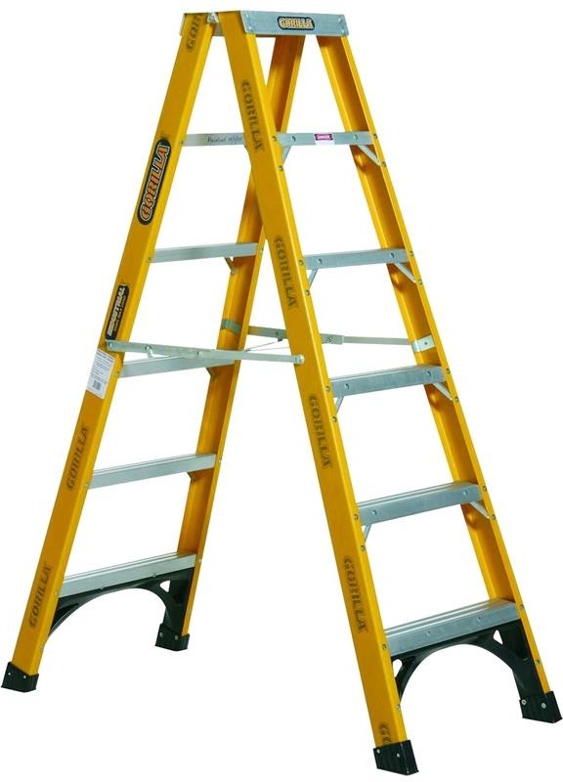
PC (c) State safety rules when working at heights
Before working at height work through these simple steps:
Avoid work at height where it's NOT reasonably practicable to do so
• Where work at height cannot be easily avoided, prevent falls using either an existing place of work that is already safe or the right type of equipment
• Minimize the distance and consequences of a fall, by using the right type of equipment where the risk cannot be eliminated

Slide 5


Slide 6
PC (d) Outline causes of pollution on site.
Noise,
Welding fumes,
Fuel gases,
Inert gases,
Gas mixtures and solvents.

Slide 7
LO 2 Demonstrate knowledge of safety in repairing tanks.
PC (a) Outline safety measures to be taken when repairing tanks
PC (b) State types of tanks that are repair welded
Types of tanks:
1)Bulk Fuel tankers
2)Auto fuel tanks

Slide 8
PC (c) Explain degreasing in metals.
Degreasing is the removal of grease and oil from a metal surface. It is a process of cleaning metals or materials subject to welding but which have contained inflammable or toxic liquids, gases or soaked with such fuel materials.
PC d) Explain degreasing processes.

Slide 9
PC (e) State safety measures to be taken when degreasing.

Slide 10
LO 3 Demonstrate skills in operating firefighting equipment.
PC (a) Describe elements and classes of fire
The classes of fire are: class A, CLASS B, and CLASS C. The Principal method of extinguishing a fire is:
STARVING (Removing the fuel)
SMOTHERING (Removing the oxygen)
COOLING (Removing the heat)

Slide 11
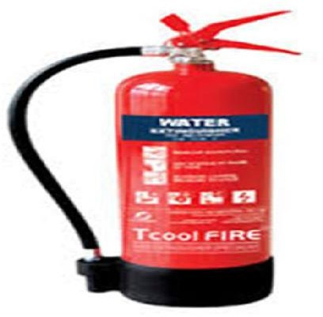
PC (b) Describe types of fire extinguishers and their applications
Water and Foam
Water and Foam fire extinguishers extinguish the fire by taking away the heat element of the fire triangle. Foam agents also separate the oxygen element from the other elements.
Water extinguishers are for Class A fires only - they should not be used on Class B or C fires.

Slide 12
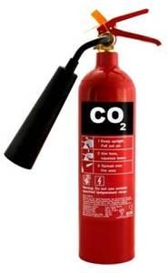
Carbon Dioxide
Carbon Dioxide fire extinguishers extinguish fire by taking away the oxygen element of the fire triangle and also be removing the heat with a very cold discharge.
Carbon dioxide can be used on Class B & C fires. They are usually ineffective on Class A fires.

Slide 13
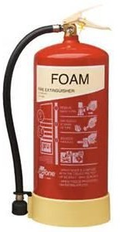
More expensive than water, but more versatile. Used for Classes A & B fires. Foam spray extinguishers are not recommended for fires involving electricity, but are safer than water if inadvertently sprayed onto live electrical apparatus.

Slide 14
PC (c) Select suitable fire extinguishers for classes of fire
Coding of fire extinguishers as follows:
Coding of fire extinguishers as follows:
Water - Red Foam - Cream
Dry Powder - Blue
Carbon Dioxide (CO2) - Black

Slide 15
CLASS ‘A’ FIRE
These are fires where the combustible material is wood, paper or textiles and all articles made from them or composed predominantly or them.
Water is the most effective agent and operates by cooling the fuel below the temperature of combustion.
There are two types of portable water extinguishers

Slide 16
CLASS ‘B’ FIRES
These are fires where the combustible material is an inflammable liquid such as oil, fat, petrol, paint or lacquer.
There are three main types of suitable fire extinguishers for use with this type of fire.
FOAM (PALE CREM Body)
DRY POWDER (BLUE Body)
CARBON DIOXI DE GAS (BLACK Body)

Slide 17
CLASS ‘C’ FIRE
This is where electrical wiring lives and equipment is involved. It is not strictly a separate class but includes risks where there is danger of electric shock.
The fire extinguishing agents must be non-conductors of electricity. Three types may be used: DRY POWER (BLUE BODY)
CARBON DIOXIDE (BLUE BODY) VAPORISING LIQUID (GREEN BODY)

Slide 18

PC (d) Operate fire extinguisher appropriately for classes of fire

Slide 19
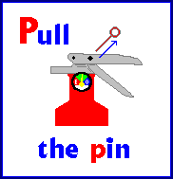

Slide 20


Slide 21
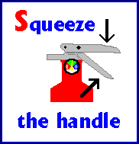

Slide 22
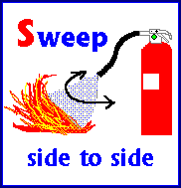

Slide 23
PC (e) Observe health and safety rules for fire fighting
Emergency planning
Fire alarms and detectors
Escape routes

Slide 24
LO 4 Demonstrate knowledge of the effects of welding fumes.
PC (a) Explain welding fumes.
PC (b) Describe types of welding fumes.
Carbon monoxide: Formed in the arc
Hydrogen fluoride: Formed in the arc
Nitric oxide: Formed in the arc
Nitrogen dioxide: Formed in the arc
Ozone: Formed in the arc
Carbon dioxide: Used as a shielding gas
Argon: Used as a shielding gas
Helium: Used as a shielding gas

Slide 25
PC (C) State effect of welding fumes
Table 1 Source and Health Effect of Welding Fumes
Fume Type | Source | Health Effect
Aluminum | Aluminum component of some alloys, e.g., Inconels, copper, zinc, steel, magnesium, brass and filler materials. | Respiratory irritant.
Beryllium | Hardening agent found in copper, magnesium, aluminum alloys and electrical contacts. | "Metal Fume Fever." A carcinogen. Other chronic effects include damage to the respiratory tract.
Cadmium Oxides | Stainless steel containing cadmium or plated materials, zinc alloy. | Irritation of respiratory system, sore and dry throat, chest pain and breathing difficulty. Chronic effects include kidney damage and emphysema. Suspected carcinogen.
Chromium | Most stainless-steel and high-alloy materials, welding rods. Also used as plating material. Converts to hexavalent chromium during welding. | Increased risk of lung cancer. Some individuals may develop skin irritation. Some forms are carcinogens (hexavalent chromium).
Copper | Alloys such as Monel, brass, bronze. Also some welding rods. | Acute effects include irritation of the eyes, nose and throat, nausea and "Metal Fume Fever."
Fluorides | Common electrode coating and flux material for both low- and high-alloy steels. | Acute effect is irritation of the eyes, nose and throat. Long-term exposures may result in bone and joint problems. Chronic effects also include excess fluid in the lungs.
Iron Oxides | The major contaminant in all iron or steel welding processes. | Siderosis – a benign form of lung disease caused by particles deposited in the lungs. Acute symptoms include irritation of the nose and lungs. Tends to clear up when exposure stops.
Lead | Solder, brass and bronze alloys, primer/coating on steels. | Chronic effects to nervous system, kidneys, digestive system and mental capacity. Can cause lead poisoning.
Manganese | Most welding processes, especially high-tensile steels. | “Metal Fume Fever.” Chronic effects may include central nervous system problems.
Molybdenum | Steel alloys, iron, stainless steel, nickel alloys. | Acute effects are eye, nose and throat irritation, and shortness of breath.
Nickel | Stainless steel, Inconel, Monel, Hastelloy and other high-alloy materials, welding rods and plated steel. | Acute effect is irritation of the eyes, nose and throat. Increased cancer risk has been noted in occupations other than welding. Also associated with dermatitis and lung problems.
Vanadium | Some steel alloys, iron, stainless steel, nickel alloys. | Acute effect is irritation of the eyes, skin and respiratory tract. Chronic effects include bronchitis, retinitis, fluid in the lungs and pneumonia.
Zinc | Galvanized and painted metal. | Metal Fume Fever.

Slide 26
PC (d) Explain fumes control in workshop

Slide 27
THANK YOU

