Slide 1
WELDING AND FABRICATION TECHNOLOGY
UNIT 2
FABRICATION PROCESSES
NCII

Slide 2
LEARNING OUTCOME
Demonstrate knowledge of metals used for fabrication
Demonstrate skills in operating cutting tools and equipment
Demonstrate skills in forming processes
Demonstrate skills in assembling structures using bolts and nuts
Demonstrate skills in assembling structures using rivets

Slide 3
LO 1 Demonstrate knowledge of metals used for fabrication
PC (a) Outline composition types of metals.
Plain Carbon steel: contain mainly iron and carbon up to about 1% with small quantise of manganese (1.65% max), silicon (0.60% max). Sulphur and phosphorus are undesirable and only found as impurities
Stainless steels are steels containing at least 10.5% chromium and other elements such as nickel, Molybdenum and Vanadium in small quantities

Slide 4
1.Copper is a pure metal but may be alloyed with Zinc, Tin, Silicon, Nickel and Aluminium
Aluminium is a pure metal but may be alloyed with copper, magnesium, manganese and silicon

Slide 5
PC (b) State functions of alloying elements in steel
Element | Quantity (%) | Functions
Carbon (c) | 0.03 – 2. | Increase hardness, strength, ductility and working properties.
Manganese | Up to 1.1 | Increases the tensile strength, hardness, toughness and hardenability.
Silicon | Up to 0.5 | It makes the metal soft.
Nickel | Up to 12 | Increases tensile strength, toughness and hardenability. Helps to form austenite, soften the steel and ensures machinability, refines the grain structure and limit grain growth.
Chromium | 16 – 30 | Increases hardenability and makes the steel resistance to wear and corrosion, reduces ductility, promote grain growth
Molybdenum | Up to 1 | Increases the tensile strength of the steel, reduces the tendency to temper brittleness, and increases the hardness, impact strength, resistance to corrosion and creep resistance at elevated temperature.
Vanadium | Up to 1 | It is useful as deoxidiser, increases the hardenability, reduces grain growth, and gives strength and resistance to fatigue at elevated temperature.
Sulphur and phosphorus | Up to 0.04 | Increases fluidity and assist in casting operation.
Titanium |  | Control grain size and used as a deoxidiser. It also stabilizes the steel against carbide precipitation and increase the corrosion resistance
Tungsten | Up to 1 | Increases the creep resistance and strength at high temperatures

Slide 6
PC (c) Explain properties of metals
Low carbon steel is soft, ductile and readily workable but these properties reduce as the carbon content increases.
Stainless steels resist atmospheric corrosion. It has lower thermal conductivity. The electrical conductivity is also low.
Aluminium has a whitish appearance, soft, malleable and very light in weight.
Copper has similar properties as aluminium except the colour for which copper is red. It major application is electrical conductors.

Slide 7
PC (d) State shapes and forms in which metals are supplied commercially

Slide 8
LO 2 Demonstrate skills in operating cutting tools and equipment
PC (a) State types of machines used for cutting in metal fabrication.
Power shears
Hand Shears
Plasma Cutter
Angle Grinder
Guillotines
Nibbler
Rotary bench cropper
Radial, pillar and sensitive drilling machines

Slide 9
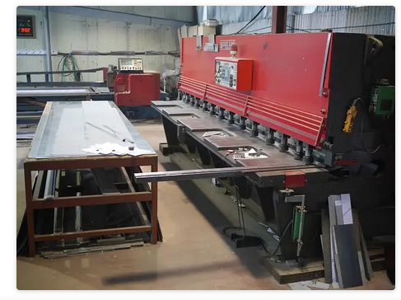
PC (b) Cut metals with guillotines

Slide 10
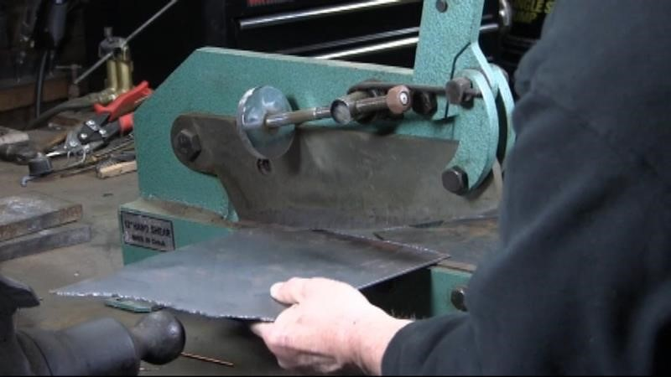
PC (c) Cut metal with shears

Slide 11
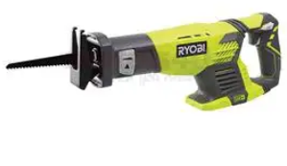
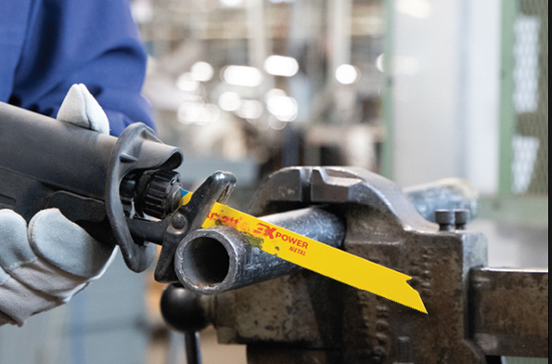
PC (d) Cut metal with saws
A. Cutting Metal with Reciprocating Saw

Slide 12
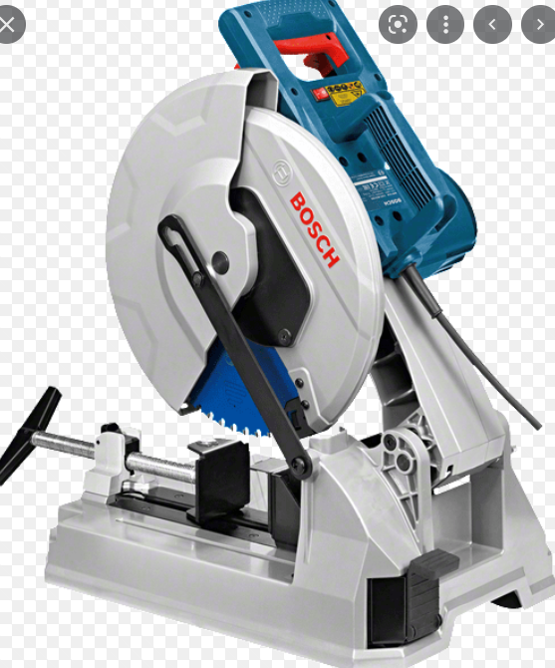
Cutting Metal with Circular Saw

Slide 13
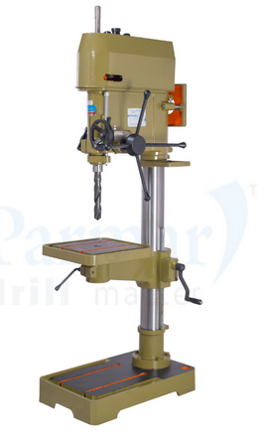
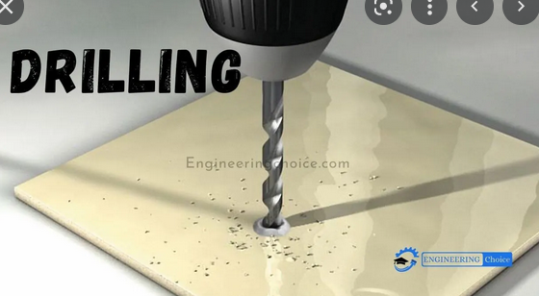

Slide 14
Procedure for Drilling
Center punch the work properly
Select the appropriate drill size
Fix drill into the drill chuck or into the spindle nose
Hold work firmly in a vice, it should be bolted if necessary
Hold the vice and work firm with one hand

Slide 15
PC (e) Observe health and safety rules when operating cutting tools and equipment

Slide 16
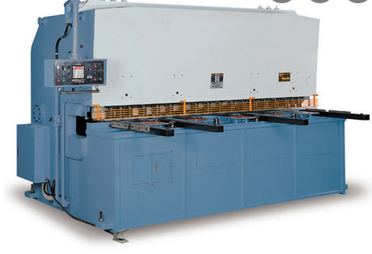
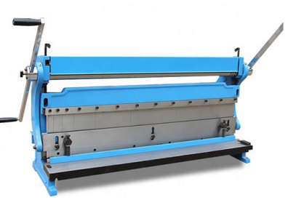
LO 3 Demonstrate skills in forming processes
PC (a) Identify types of machines for forming
Manual former
Power former (Hydrolic))

Slide 17
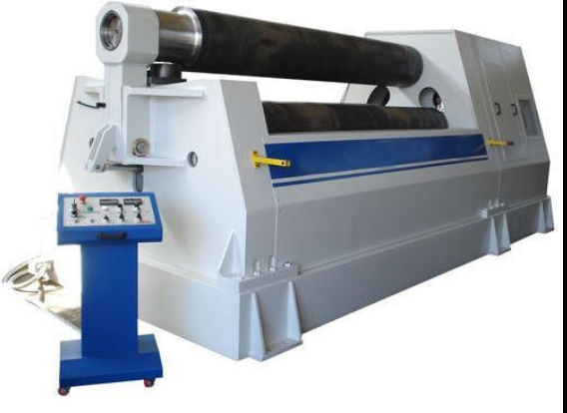
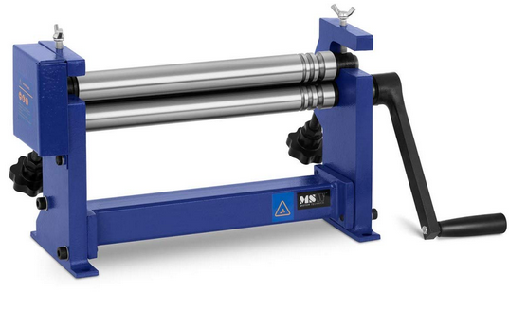

Slide 18
PC (b) Outline methods of forming
Forging: Is a process forming metal articles by heating and hammering
Bending is a process by which metal can be deformed by applying force to bend it at an angle and form the anticipated shape
Rolling is the process of bending metal sheets/plate to a curved form by passing through one or more pairs of rolls.

Slide 19
PC (c) Set up machine for forming
First, adjust the upper beam and folding plate,
Put the plate between the beams
Fasten the angle positioning plate on the left shaft
Rotate the folding plate to an angle positioning point then you can begin folding

Slide 20
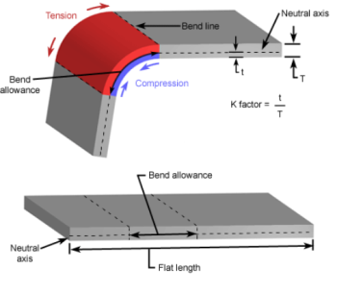
PC (d) Calculate allowances for forming
Bend allowance

Slide 21
Here, B = Bend Angle in degree,
IR = Inside Radius
K = K-factor (It is different for different material and depend upon the physical properties)
MT = Material Thickness

Slide 22
PC (e) Operate machine to form components to specified shapes
PC (f) Observe safety when using forming tools and equipment

Slide 23
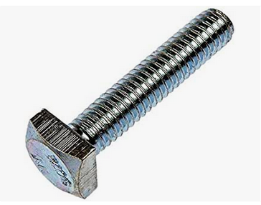
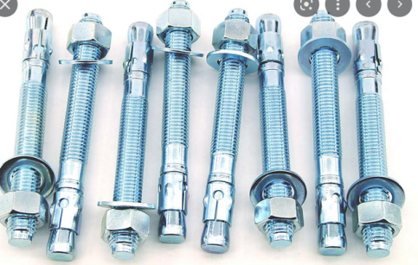
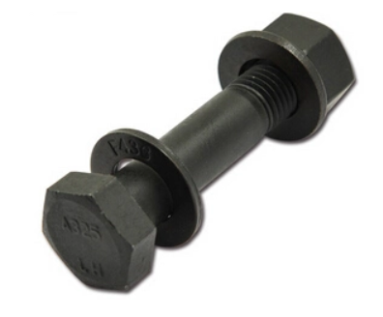
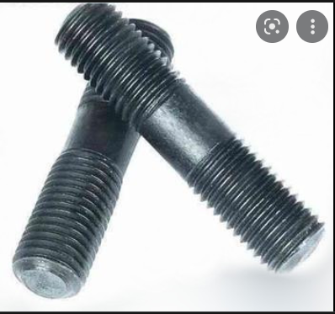
LO 4 Demonstrate skills in assembling structures using bolts and nuts
PC (a) Identify types of bolts and nuts for structural works

Slide 24
PC (b) Classify threads according to BSPT & BSPP, ISO - 724 and ANSI B1.1

Slide 25
PC (c- d) Assemble parts using bolts and nuts
PC (d) Observe safety when using drilling tools

Slide 26
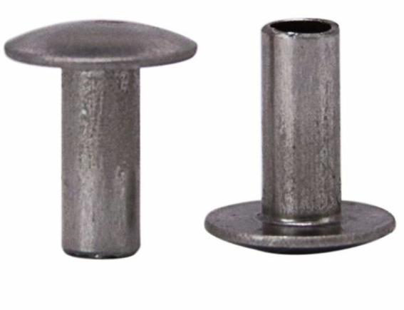
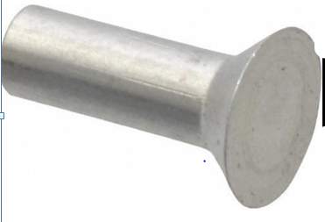
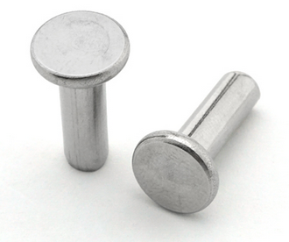
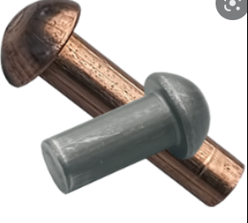
LO 5 Demonstrate skills in assembling structures using rivets
PC (a) Identify types of rivets used for structural works
Countersunk head rivets
Flat head rivets
Pan head rivets
Snap head rivets

Slide 27
PC (b) State application of the types of rivets
1.Flat head rivets: it generally used for attaching or joining sheet metals.
Countersunk head rivets: they are used where flush surfaces are required for instance attaching handles to a knife.
Pan and Snap head rivets These rivets are commonly used in large structural work where strength is needed.

Slide 28
PC (c) Calculate rivets length and size according to the thickness of the material to be joined
Length of the rivet shank (L) is calculated by:
L = 1.5D + MT
Calculate the length of rivet required to join two 4mm plates together if the rivet diameter 5mm.
MT = 4mm x 2 = 8mm
D = 5mm
L = 1.5 x 5mm + 8mm
L = 10.5mm

Slide 29
PC (d) Rivet materials together
PC (f) Observe safety during riveting

Slide 30
PC (f) Observe safety during riveting

