Slide 1
WELDING AND FABRICATION TECHNOLOGY
UNIT 4
METAL WORK TOOLS AND EQUIPMENT
NC1

Slide 2
LEARNING OUTCOMES
Demonstrate knowledge of metal work tools
Demonstrate knowledge of metal work equipment
Demonstrate skills in using metal work tools

Slide 3
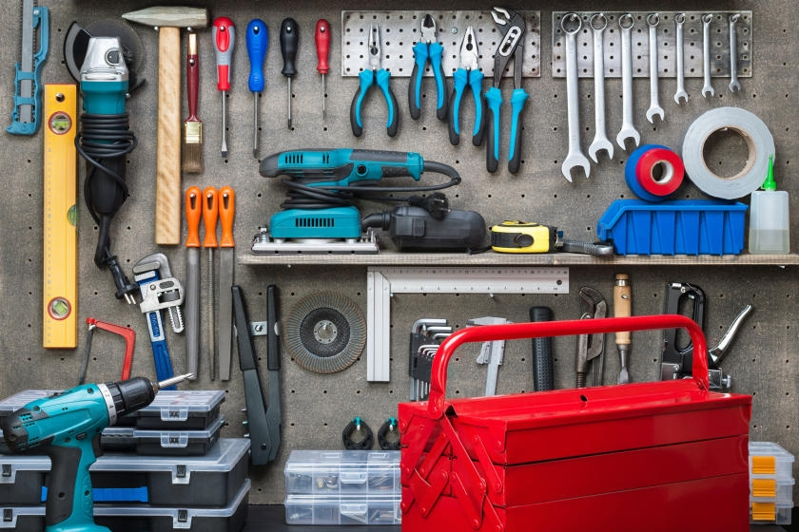
LO 1 Demonstrate Knowledge of Various Metal Work Tools.
PC (a) State various types of metal work tools.

Slide 4
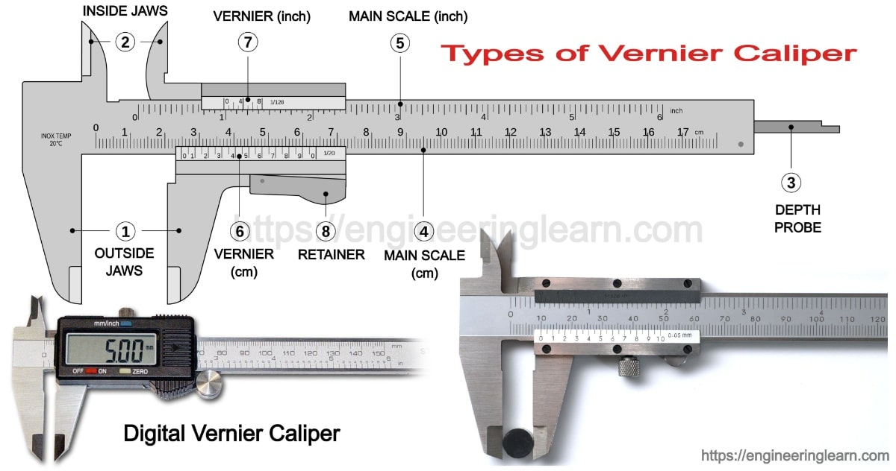
PC (b) Explain the uses of the types of metal work tools.

Slide 5
PC (c) Explain how to care for metal work tools.
Oil metallic and moving parts of a hand tool to reduce friction and corrosion.
Never use a hand tool without a handle
Files should be cleaned as soon as they clogged by using a file card
A metal work must learn to select the right type of tool for the particular work at hand
Never use a file on welded joints or on the surface of casting

Slide 6

PC (d) Describe how to carry out maintenance on metal work tools.

Slide 7
LO 2 Demonstrate knowledge of metal work equipment
PC (a) List the various equipment for metal work
Grinding Machine
Drilling Machines
Saw Machines
Circular Saw
Hacksaw
Hand grinders

Slide 8
PC (b) Describe the types of metal work equipment.
PC (C) Explain the uses of the types of metal work equipment.

Slide 9
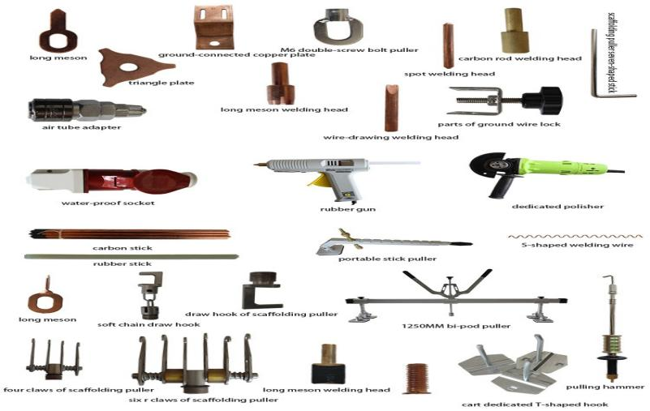
LO 3 Demonstrate skills in using metal work tools
PC (a) Carry out labelling and sorting of metal work tools

Slide 10
PC (b) Select the appropriate metal work tools for given task.
PC (c) Use the selected tool to carry out the given task.

Slide 11
THANK YOU

