Slide 1
WELDING AND FABRICATION TECHNOLOGY
UNIT 5
INTRODUCTION TO FABRICATION OF STRUCTURAL WORK
NC1

Slide 2
LEARNING OUTCOMES
Demonstrate knowledge of various forms and shapes of metals
Demonstrate skills in measuring and marking out of metals
Demonstrate skills in using templates for marking out
Demonstrate skills in cutting and inspection of components part

Slide 3
LO 1 DEMONSTRATE KNOWLEDGE OF VARIOUS FORMS AND SHAPES OF METALS
PC (a) State the shape and forms of metals used in structural work.
Channel which come forms of “U” and “H”
Bars in forms of: round, hexagonal, angle and Tee
Tubes in forms of square, rectangular and round
Sheet metal
Plate

Slide 4
These structural steel shapes and forms of metal are used as structural members for building bridges and other structural works:
Column: a load bearing vertical structural member
Beam: A load bearing horizontal member
Rafters: A sloping structural members that met at ridge
Purlins: They are horizontal crossing members

Slide 5
PC (b) Outline the standards used in structural work
Carbon steels
•A36 - structural shapes and plate.
•A53 - structural pipe and tubing.
•A500 - structural pipe and tubing.
•A501 - structural pipe and tubing.
•A529 - structural shapes and plate.

Slide 6
PC (c) State the Codes used in structural steel work
I.S. 226 : Structural steel (standard quality)
I.S. 808 : Rolled steel beams, channel and angles sections.
I.S. 1099 : Structural steel (ordinary quality)
ASTM 06 : General requirements for delivery of rolled steel plates, sheet piling and bars for structural use.
I.S. 1367 : Technical supply conditions for threaded fasteners

Slide 7
PC (d) Explain the uses of forms and shapes of metal
Construction
Military
Ship construction
Pressure vessels
Shipping
Oil and gas
Household appliances

Slide 8
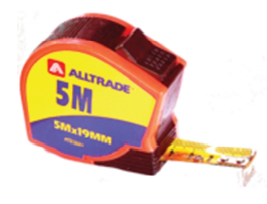
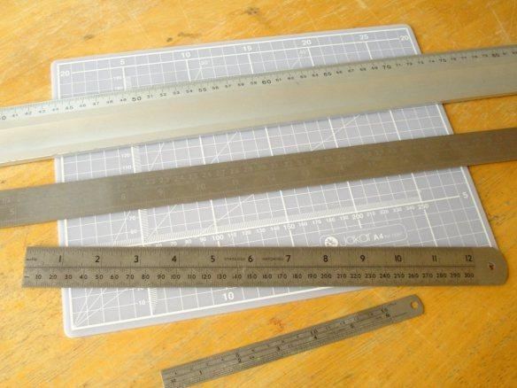
LO 2 DEMONSTRATE SKILL IN MEASURING AND MARKING OUT METALS
PC (a) Identify measuring and marking out tools

Slide 9
PC (b) Describe uses of measuring and marking out tools
PC (c) Select suitable measuring and marking tools for a given task
PC (d) Measure and mark out work piece
PC (e) Keep record of all measurements taken

Slide 10
LO 3 DEMONSTRATE SKILLS IN USING TEMPLATES FOR MARKING OUT
PC (a) Select suitable material for marking template
Materials for making template
PC (b) Develop and label template for marking out work pieces
PC (c) Illustrate the use of template for marking out

Slide 11
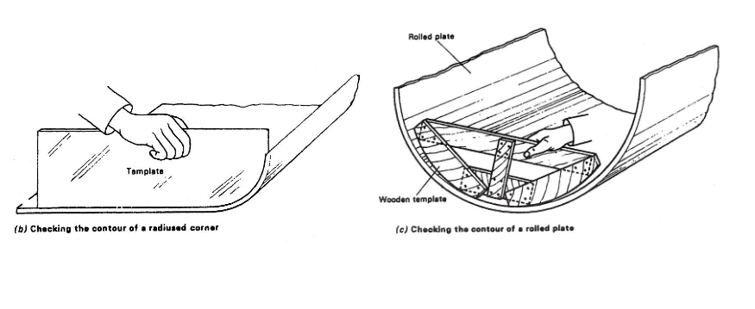
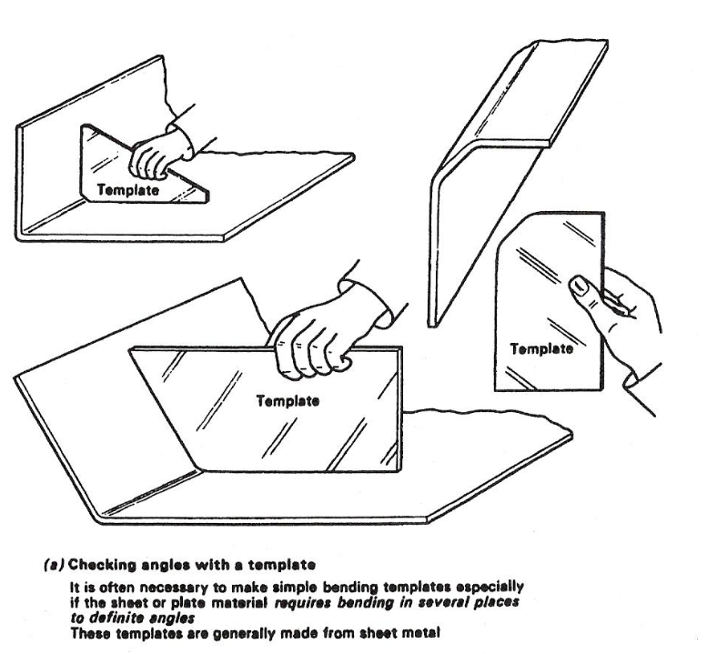

Slide 12
PC (d) Keep template safely

Slide 13
LO 4 DEMONSTRATE SKILL IN CUTTING AND INSPECTION OF COMPONENTS PART
PC (a) Identify cutting tools and equipment for metals
Angle grinder
Pedestal grinder
Hand File
Hand shears
Bench shear
Guillotine

Slide 14
PC (b) Set work for cutting
PC (c) Cut metal to required dimension
PC (d) Clean and inspect components.
PC (e) Observe safety rules and regulations

Slide 15
THANK YOU

