Slide 1
WELDING AND FABRICATION TECHNOLOGY
UNIT 6
WELDING ELECTRODES
NC1

Slide 2
LEARNING OUTCOMES
Demonstrate knowledge of welding electrodes
Demonstrate knowledge in the classification of welding electrodes by the British Standard (BS).
Demonstrate knowledge in the classification of welding electrodes by the American Welding Society.

Slide 3
LO 1Demonstrate knowledge of welding electrodes
PC (a) Describe a welding electrode.
PC (b) Explain the functions of the core wire.
The core wire conducts electric current to the arc
It generates the heat with the help of the arc to melt the base metal
It provides the filler material for the welding joint.

Slide 4
PC (c) State the functions of the flux coating.
It protects the weld pool and solid metal from atmospheric contamination
It helps in removing impurities from the weld pool.

Slide 5
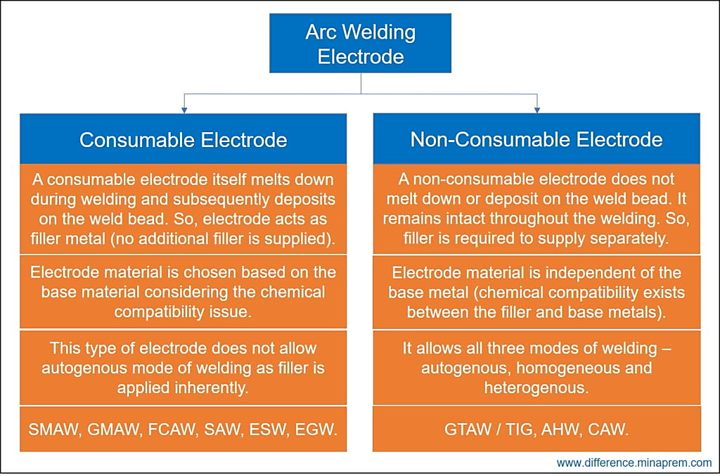
PC (d) Distinguish between consumable electrodes and non-consumable electrodes

Slide 6
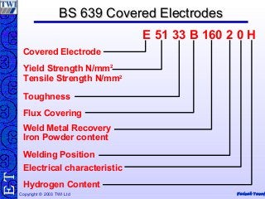
LO 2 Demonstrate knowledge in the classification of welding electrodes by the British Standard (BS).
PC (a) Explain electrode classification according to BS 639.

Slide 7
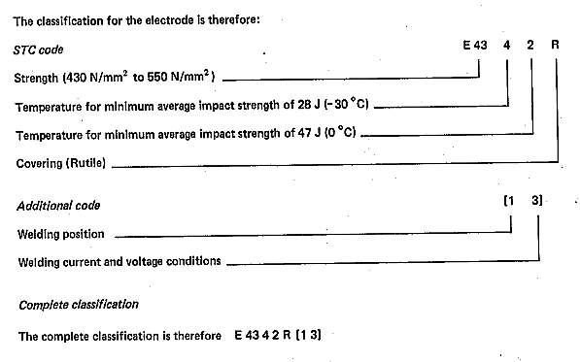
PC (b) Identify elements in the classification of the general code in BS 639
PC (c) Explain the additional coding in the BS 639
PC (d) Decode electrodes classified according to BS 639

Slide 8
LO 3 Demonstrate knowledge in the classification of welding electrodes by the American Welding Society.
PC (a) Explain electrode classification according to AWS A5 1 81.
PC (b) Identify the elements classified in the first two digits of the AWS A5 1 81 code.
PC (c) Explain the information provided in the last two digits of the AWS A5 1 81.
PC (d) Decode electrodes classified according to ANSI / AWS A5 1 81.

Slide 9
SELECTION OF ELECTRODE

Slide 10
THANK YOU

