Slide 1
WELDING AND FABRICATION TECHNOLOGY
UNIT 10
DRAWING IN WELDING & FABRICATION II
NC2

Slide 2
LEARNING OUTCOME
Demonstrate skills in producing welded joints
Demonstrate understanding of pictorial views of objects
Demonstrate understanding in reading working drawings
Demonstrate skills in parallel line development
Demonstrate skills in radial line development

Slide 3
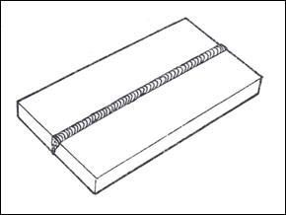
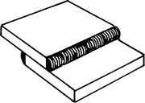
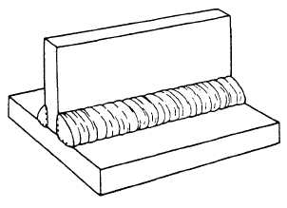
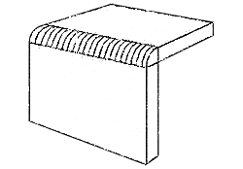

LO 1: Demonstrate knowledge of sketching welded joints

Slide 4
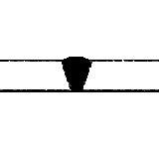

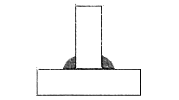
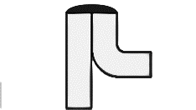
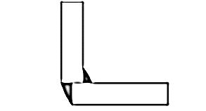
PC b. Sketch Sectional views of welded joints

Slide 5
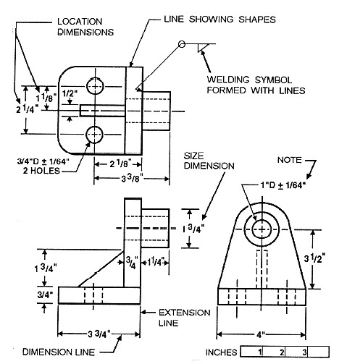
PC c. Draw Orthographic views of welded joints

Slide 6
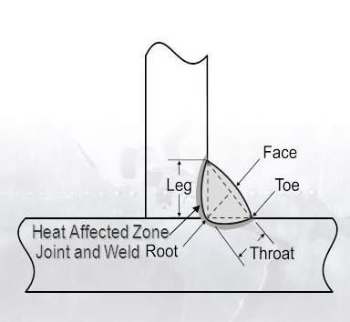
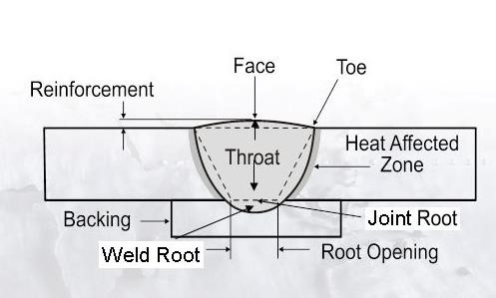
PC d. Label Parts of welded joints

Slide 7
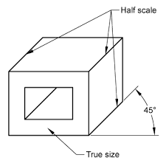
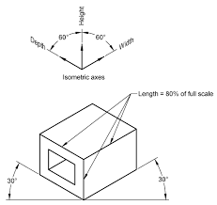
L.O.2 Demonstrate knowledge of pictorial views of objects
PC (a) Draw views of objects

Slide 8
PC (b) Convert pictorial drawings to orthographic projection
Orthographic projection is a method of representing three-dimensional objects, usually by three two-dimensional drawings in each of which the object is viewed along parallel lines that are perpendicular to the plane of the drawing. For example, an orthographic projection of a house typically consists of a top view, or plan, and a front view and one side view (front and side elevations).

Slide 9
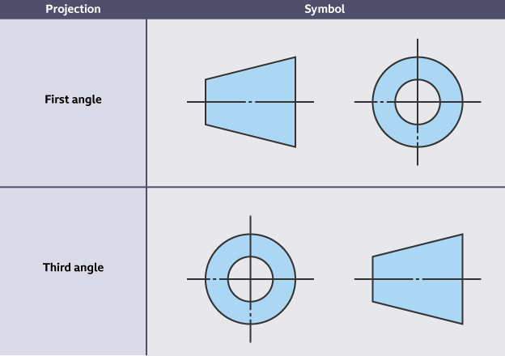
There are two main types of Orthographic Projections and they are;
First angle Projection and Third angle projection.

Slide 10
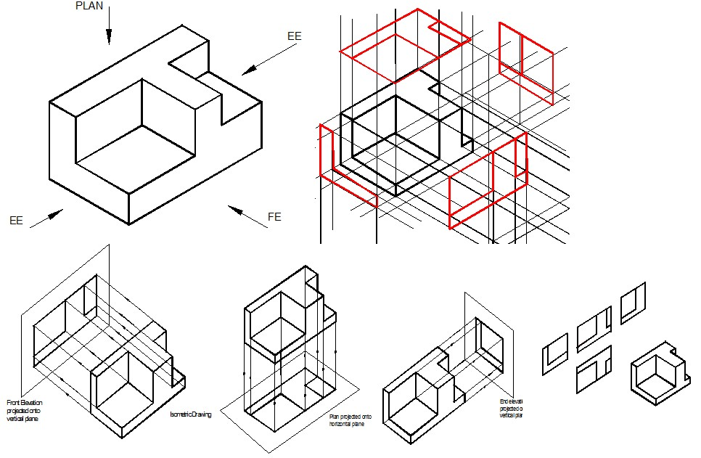

Slide 11
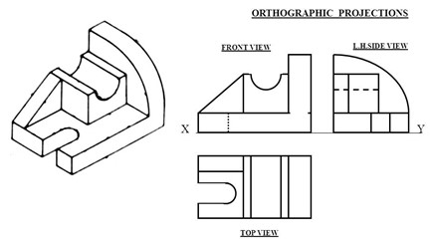
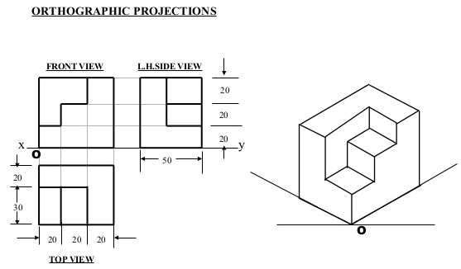
Examples of First Angle Projection

Slide 12
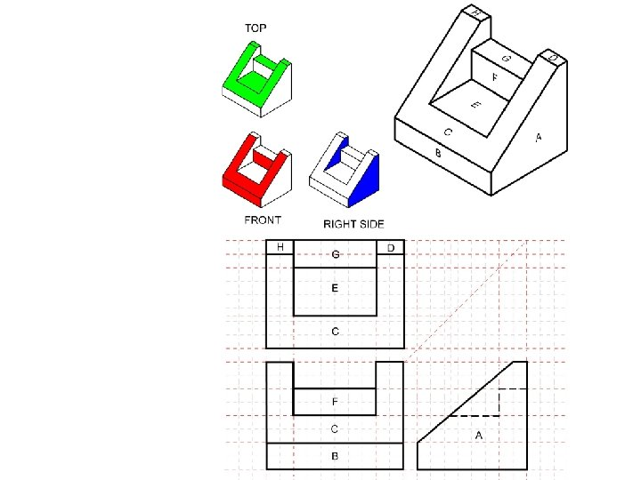
Example of Third Angle Projection

Slide 13
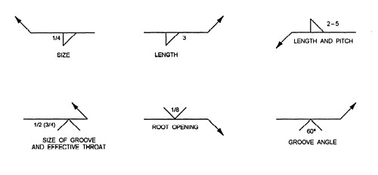
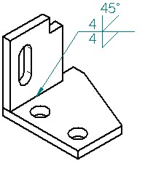
PC c. Indicate weld symbols on drawing

Slide 14
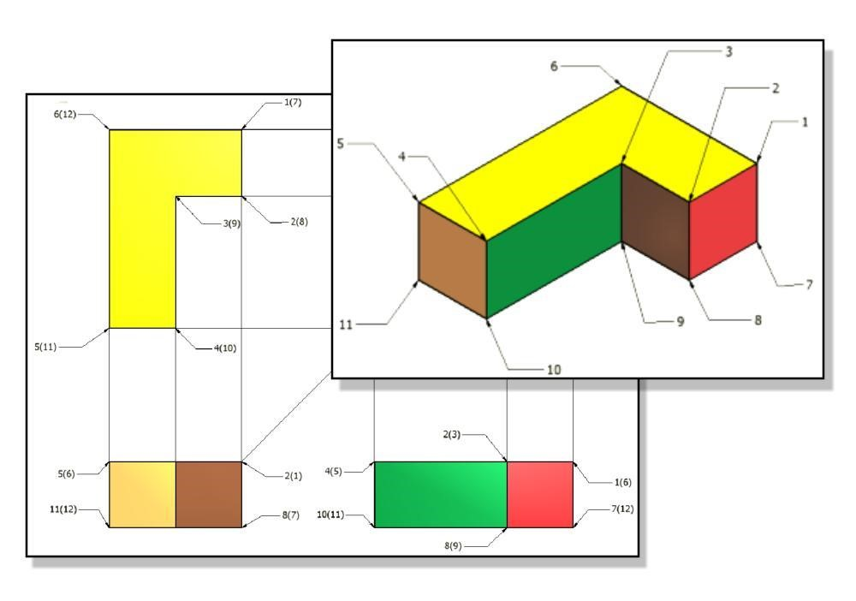
PC d. Convert orthographic to pictorial drawings

Slide 15
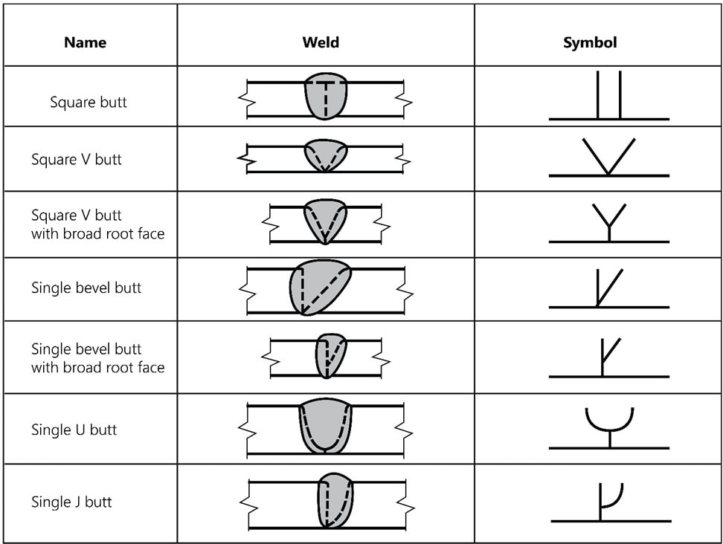
LO 3 Demonstrate knowledge of reading working drawings
PC (a) Identify types of welding symbols on working drawings.

Slide 16
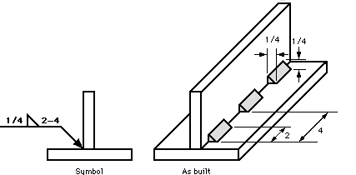
PC b. Interpret welding symbols with 3-dimensional drawing.

Slide 17
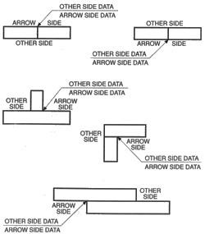
PC c. Interpret welding symbols with 2-dimensional drawing.

Slide 18
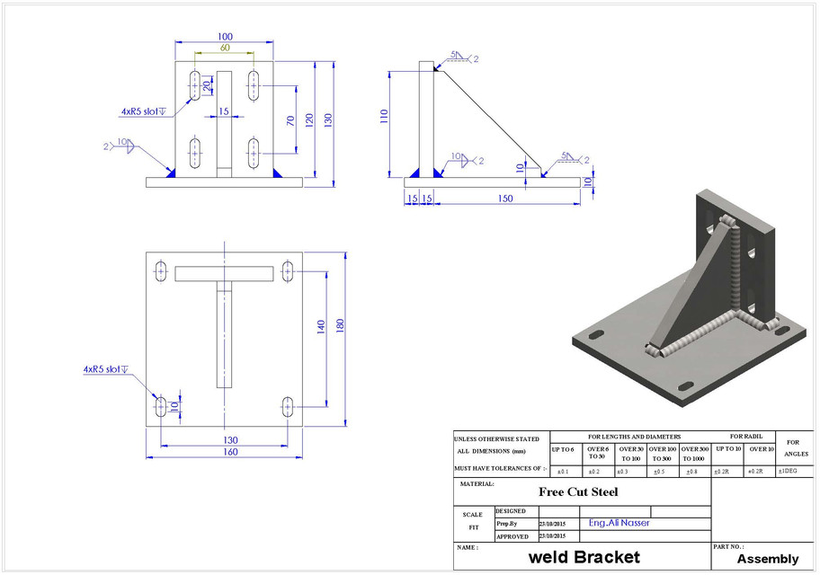
PC d. Interpret working drawing in relation to welding.

Slide 19
LO 4 Demonstrate knowledge of parallel line development
PC (a) Identify types of parallel line surface developments of objects

