Slide 1
WELDING AND FABRICATION TECHNOLOGY
UNIT 9
MANAGING A WELDING WORKSHOP
NCII

Slide 2
LEARNING OUTCOMES
Demonstrate knowledge in setting up a workshop
Demonstrate knowledge in running a workshop
Demonstrate knowledge of shop layout and planning of work
Apply the 5S in the workspace (Japanese concept)

Slide 3
LO 1. Demonstrate knowledge of setting up a workshop
PC (a) Explain Factors influencing location of a welding workshop.
Developmental activities
Development activities include a number of factors that will ensure the smooth running of the business such as:
Communication and transportation facilities,
Power and fuel sources,
Availablity of labor,
Market (purposefully for sale of products)
Adequate Banking and credit facilities,
Facilities of Repairs

Slide 4
Source of electricity
Unless it is an Oxy-fuel gas welding workshop, a standard welding workshop should be situated close to where there is the availability of electricity. In the welding work, electricity is needed to power most of the power tools like the welding machine, hand drilling machine and the angle grinder.

Slide 5
PC (b) State Procedure for registering a new business.
Choose Your Business Name
Register Your Business Name
Applicant may pick up a prescribed Form A from the in-house bank
Submit filled forms at the bank in addition with a processing fee
Registrar examines and issues business registration certificate as well as certified true copy of the form to be submitted as attachment
Renewal each year

Slide 6
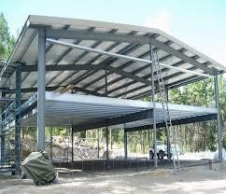
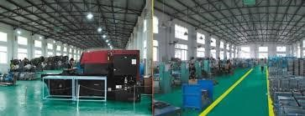
PC (c) Describe type of building that is suitable for a welding workshop.

Slide 7
PC (d) Explain Advantages of proximity of raw materials to the workshop

Slide 8
LO 2. Demonstrate knowledge of running a workshop
PC (a) Outline importance of record keeping in a welding workshop.
Assist you in preparing your financial statements quickly and accurately.
Provide information to enable the control of cash in the business.
Contribute promptly to assessing the financial situation of the business at any time.
Save a lot of time and effort.
Keep a good track of the costs of staff and their performance.
Measure the business performance against the projections that were originally set down in the business plan.

Slide 9
PC (b) State importance of marketing a product.
Marketing is a process by which a product or service is introduced and promoted to potential customers. The heart of your business success lies in its marketing. Most aspects of your business depend on successful marketing.

Slide 10
PC (c) State importance for paying taxes.
Taxation is a major source of revenue to the government. It helps government to have access to loan. Government uses it to control the country. Without it there will be no social services such as road, education, sports and games, health, water, electricity and law enforcement.

Slide 11
PC (d) Identify tax and revenue organizations in Ghana.
Ghana Revenue Authority (Customs, Internal Revenue Service, Value Added Tax)
Municipal and District Assemblies
Social Security National Trust Fund (SSNIT).

Slide 12
PC (e) State implication of evading tax in Ghana
Court imposed fines
Jail term
Criminal record

Slide 13
PC (f) State importance of maintaining a good customer relationship
Customer acquisition
This is one of the major plus points of a positive customer relationship. When your customers think that they can rely on you as a business, they are very likely to opt for your business. Besides, they might also refer your business to their peers, acquaintances, etc.
Customer retention
Customer satisfaction

Slide 14
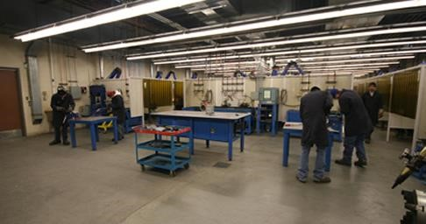
L. O 3. Demonstrate knowledge of shop layout and planning of work
PC (a) Explain proper shop layout.

Slide 15
PC (b) Draw a simple layout of a welding workshop.
Fabrication Area | Welding Area | Finishing Area
• Working Benches area • Tools Storage area | • Welding Booth area • Welding Benches area • Welding Screens | • Air compressors storage area • Paints Storage area
• Jigs and Fixtures area • Gas Storage area | • Welding Machines • Consumables Storage area • Tools storage area • Shielding Gases Storage

Slide 16
PC (c) Outline means of mobilizing resources needed to setup a welding workshop.
Self-support
Access loan from financial institutions
Support from the family
By leasing
Through hire purchase
Non-Governmental Organization (N.G.O)
Philanthropist

Slide 17
PC (d) List resources needed to setup a welding workshop
Capital Resources
Capital resource include money to start a business, tools, building and machinery
Natural Resources
Natural Resources may include, raw materials, land, source of water, source of food and fuel.
Human Resources
Human Resources is the human capacity (labor) that is used to run a business.

Slide 18
L.O. 4 Demonstrate skill Apply 5S in the workspace (Japanese concept)
PC (a) Explain 5S concept
PC (b) Explain 5S processes
Seiri - sort
Seiton - straighten/ set in order
Seiso - shine
Seiketsu - standardize
Shitsuke – sustain

Slide 19
Sort - sort out and separate that which is needed and not needed in the area.
Straighten - arrange items that are needed so that they are ready and easy to use. Clearly identify locations for all items so that anyone can find them and return them once the task is completed.
Shine - clean the workplace and equipment on a regular basis, in order to maintain standards and identify defects.
Standardize - revisit the first three of the 5Ss on a frequent basis and confirm the condition of the Gemba (the factory floor) using standard procedures.
Sustain - keep to the rules to maintain the standard and continue to improve every day.

Slide 20
PC (c) Conduct the 5S audit at the workspace.
The 5S audit is the process of evaluating the proper implementation of 5S in the workplace. Conducting 5S audits can help ensure that the workplace is consistently following a proper procedure and become more efficient.
PC (d) Create 5S action plan.
PC (e) Implement the 5S at the workspace

Slide 21
THANK YOU

