Slide 1
WELDING AND FABRICATION TECHNOLOGY
UNIT 11
OXY FUEL GAS CUTTING AND GOUGING
NCII

Slide 2
LEARNING OUTCOMES
Demonstrate knowledge of gas cutting
Demonstrate skill in performing gas cutting with manual torch
Demonstrate knowledge in flame gouging
Demonstrate skill in performing flame gouging
Demonstrate knowledge of examining quality of a cut edge

Slide 3
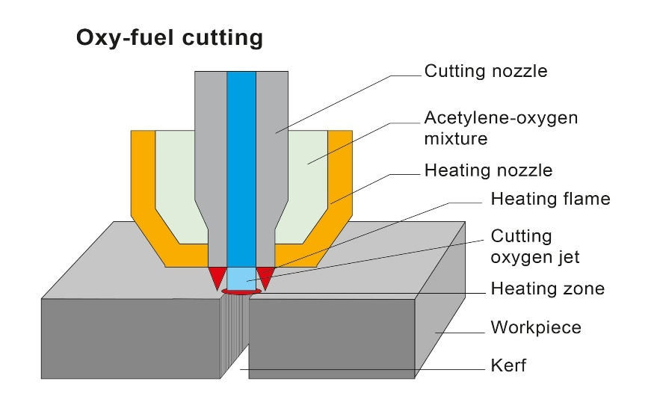
LO 1 Demonstrate knowledge of gas cutting
PC (a) Explain principle of oxy fuel gas cutting

Slide 4
PC (b) State types of gases for cutting
Acetylene gas
Propane gas
Propylene gas
Natural gas
Butane,
Methane,
Hydrogen,
LPG

Slide 5
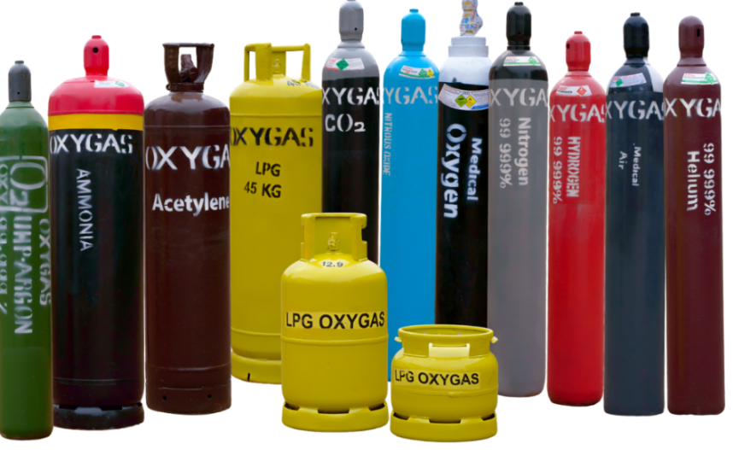

Slide 6
PC (c) State equipment used for oxy fuel gas cutting
Torches
Regulators
Gas cylinders
Gas hoses
Valves
Spark lighter
Flash back arrestor
Gas economizer
Hose checker

Slide 7
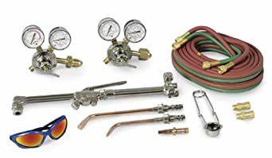

Slide 8
PC (d) Explain the applications of oxy fuel gas cutting.
It is used in domestic workshops to cut metals
In ship building
In factories and industries
Automated versions of gas cutting processes are applied in manufacturing industries

Slide 9
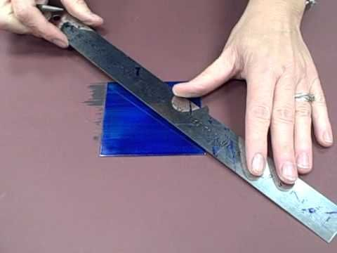
LO 2 DEMONSTRATE SKILL IN PERFORMING GAS CUTTING WITH MANUAL TORCH.
PC (a) Assemble equipment for oxy fuel gas cutting
PC (c) mark out 10mm low carbon steel plate to required dimension

Slide 10
PC (d) Set flame for oxy fuel gas cutting.
Open the fuel gas torch valve about half way
Light the torch by squeezing the spark lighter (striker) about an inch away from the tip.
Be sure to wear gloves
Turn up fuel gas valve until the flame jump slightly off the tip
Add oxygen to the flame until it become neutral
Now you are ready to cut.

Slide 11
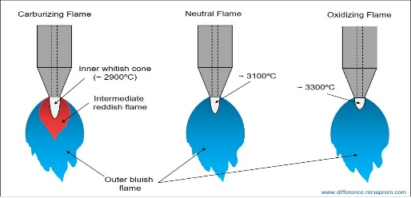

Slide 12
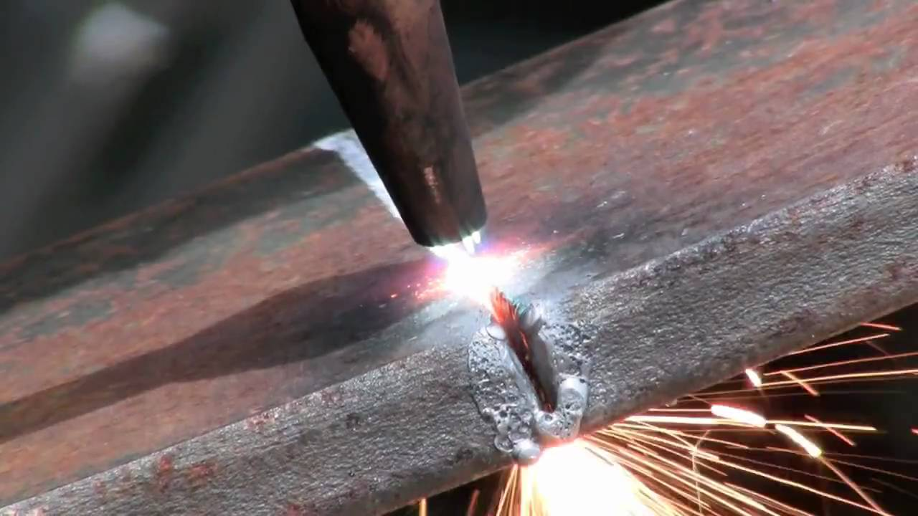
PC (e) cut 10mm plate to required dimension and shape with oxy fuel gas

Slide 13
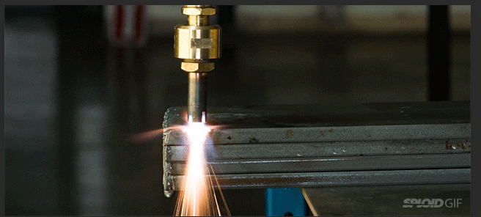
PC(f) Cut stack material to required dimension and shape with oxy fuel cutting

Slide 14
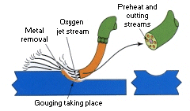
LO 3 Demonstrate knowledge of flame Gouging

Slide 15
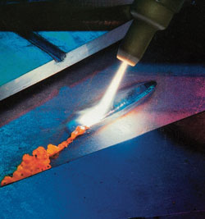
PC (a) Describe principle of oxy fuel flame gouging

Slide 16
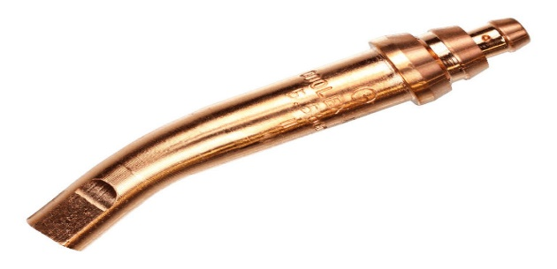
PC (b) Describe types of gouging nozzle

Slide 17
PC (c) Explain gouging techniques
PC (d) State applications of gouging
Removing defects
Preparing grooves
Removing tack welds

Slide 18
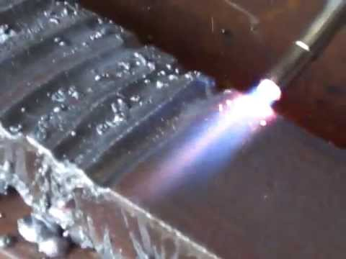
LO4 Demonstrate skill in performing flame gouging

Slide 19
PC(a) fix the suitable gouging nozzle
PC (b)set suitable flame for gouging
PC (c) Perform gouging with spot gouging Technique
PC (d) Perform gouging with progressive technique

Slide 20
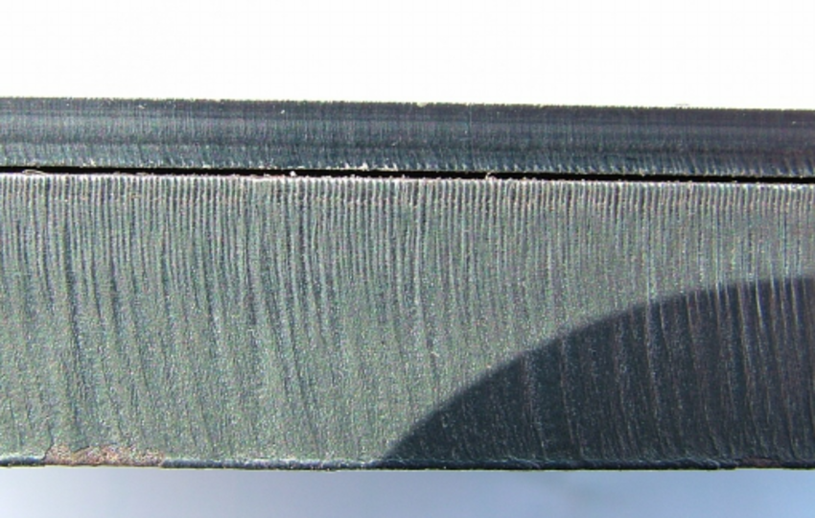
LO 5 Demonstrate knowledge of examining qualities of cut edge.
PC (a) Identify qualities of a good cut edge

Slide 21
PC (b) identify defects on cut edge
PC (c) state causes of defects on cut edge
Cutting speed too high
Nozzle too far from the surface
Nozzle too near to the surface
Excess cutting oxygen
Excess preheating

Slide 22
PC (d) Explain how defect can be avoided in cutting
Using a normal traveling speed
A correct distance of nozzle from the plate
A good oxygen pressures

Slide 23
THANK YOU

