Slide 1
WELDING AND FABRICATION TECHNOLOGY
UNIT 20
CUTTING WITH AIR CARBON ARC PROCESS
NC1

Slide 2
LEARNING OUTCOMES
Demonstrate knowledge of equipment used for cutting
Demonstrate skills in assembling cutting equipment
Demonstrate skills in performing Air Carbon Arc Cutting operation.

Slide 3
PC (a) Describe Air Carbon Arc Cutting process
Air carbon arc cutting is a process of removing metal by means of heat generated from a carbon arc. This process employs a carbon/graphite electrode, compressed air and a standard power source. The intense heat arc created between the electrode and a metal work piece cuts and melts the work piece. At the same time, the molten metal is blown away by the compressed air.

Slide 4
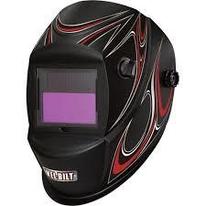
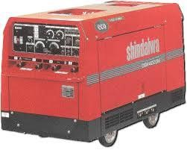
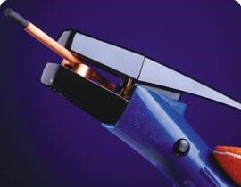
PC (b) Identify Air Carbon Arc Cutting equipment
Air Carbon Cutting machine Carbon arc electrode and holder

Slide 5
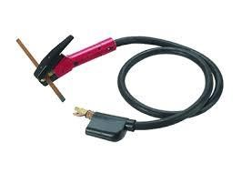
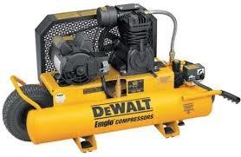

Slide 6
PC (c) Describe electrode for Air Carbon Arc Cutting
PC (d) State source of air supply for Air Carbon Arc Cutting
PC (e) State the advantages of Air Carbon Arc Cutting

Slide 7
LO 2 Demonstrate skills in assembling cutting equipment
PC (a) State equipment for Air Carbon Arc Cutting.
Work piece lead
Air carbon arc torch, with an air jet device
Carbon/ Graphite electrodes
Electrode lead
A compressed air hose
DC or AC Welding Machine
Compressed Air

Slide 8
PC (b) Select suitable source of power for Air Carbon Arc Cutting
Air carbon arc cutting requires a three-phase welding power source with high capacity.

Slide 9
PC (c) Assemble equipment for Air Carbon Arc Cutting
Connect gouging machines either a/c or dc
Connect the electrode holder to the machine
Connect the holder to the gouging/cutting torch
Connect the air hose to the gouging/cutting torch
Grip the carbon electrode to the gouging torch.

Slide 10
LO 3 Demonstrate skills in Air Carbon Arc Cutting.
PC (a) Select appropriate carbon electrode for cutting.
PC (b) Select suitable current for Air Carbon Arc Cutting
PC (c) Adjust suitable air pressure for cutting.
PC (d) Cut metal with the Air Carbon Arc cutting process.

Slide 11
THANK YOU

