Slide 1
WELDING AND FABRICATION TECHNOLOGY
UNIT 19
INTRODUCTION TO PIPE FITTING
NC1

Slide 2
LEARNING OUTCOME
Demonstrate knowledge of pipe fitting
Demonstrate skills in preparing materials for pipe fitting
Demonstrate skills in performing pipe fitting

Slide 3
L.O.1. Demonstrate knowledge in pipe fitting
Pc (a) Describe pipe fitting process
Pipe fittings are defined as the piping components that help in pipe routing for directional changes, size changes, and branch connections.

Slide 4
PC (b)State the situations which require pipe fitting
Manufacturing
Hydraulics
Refineries
nuclear- power

Slide 5
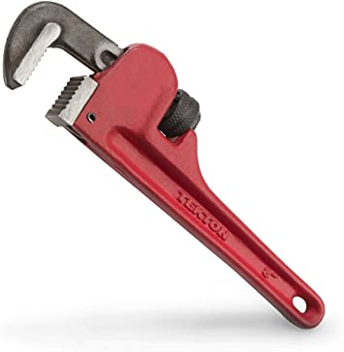
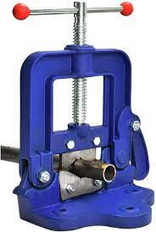
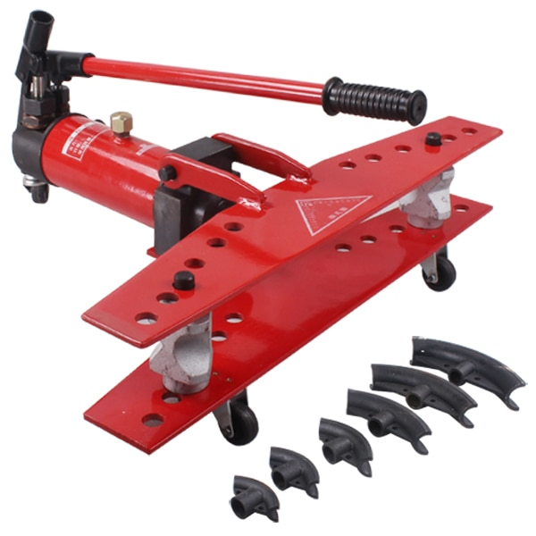
PC (c) Identify tools and equipment for pipe fitting
Pipe Wrench
Pipe Cutter
Pipe Bender (Hydraulic

Slide 6
PC(d) State types of pipe fitting joints
Elbow
Tee
Reducer
Union
Coupling
Adapters
Valve

Slide 7
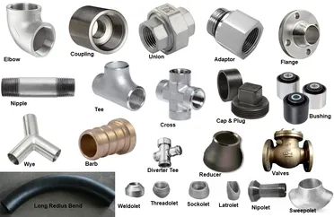

Slide 8
LO 2 Demonstrate skills in preparing materials for pipe
fitting.
This LO is developed to help you demonstrate in skills in preparing material for pipe fitting. To achieve this, we will go through PCs (a) – (c).

Slide 9
PC (a) Select equipment for pipe fitting.
PC (b) Assemble equipment for pipe fitting.
PC (c) Bend pipes to correct angle

Slide 10
Checklist
No |  | Yes | No
1 | Proper use of PPE’s
2 | Correct use of tools
3 | Identification of equipment’s
4 | Identification types of fittings
5 | Hold pipe firm in vice
6 | Bend pipe to required shape and angle
7 | Observing safety rules and regulation

Slide 11
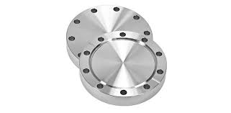
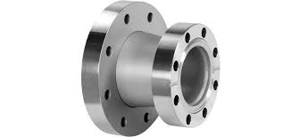
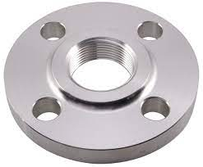
LO 3 Demonstrate skills in preparing materials for pipe fitting.
PC (a)Identify pipe flanges
Blind flanges Reducing flanges Threaded flange

Slide 12
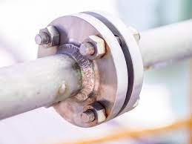
PC(b) Select flanges to fit the pipe
PC (c) Use appropriate tool to align flanges.
PC (d) Attach flanges to the pipe by welding

Slide 13
No |  | Yes | No
1 | Proper use of PPE’s
2 | Correct use of tools
3 | Correct use of equipment
4 | Align flange correctly
5 | Appropriate post – welding treatment carried out
6 | 24 holes drilled evenly
7 | Observing safety rules and regulation

Slide 14
LO 4 Demonstrate skills in finishing work
To achieve this, we will go through PCs (a) – (d).
PC (a) Clean the work piece before inspection
PC (b) Inspect the work piece for any defects
PC (c)Rectify the defects on the weld
PC(d) Finish the work piece and apply coating as instructed

Slide 15
Checklist
No |  | Yes | No
1 | Proper use of PPE’s
2 | Correct use of tools
3 | Correct use of equipment
4 | Welding defect rectified
5 | Observing safety rules and regulation
6 | Handling of testing devices

Slide 16
Thank you

